Slide 1



INTELLI-METER: A Virtual Prototyping Framework for Smart Metering using Advanced Algorithms
Osama Abdulqadir
Abdulrahman Mahjoub
Supervised by:
Dr. Malek Al-Duhaymi
Dr. Brahim Mrabet

Slide 2

Outline
Introduction
Problem
Solution
Proposed Framework
Load disaggregation
Load forecasting
Theft Detection
Model & Dataset
Results
Prototyping

Slide 3
Check up list
Design a proposed framework for the project ✓
Implementing Load disaggregation algorithms on appliances ✓
Writing a Google Colab Notebook as a reference for the project ✓

Slide 4
Introduction

Slide 5
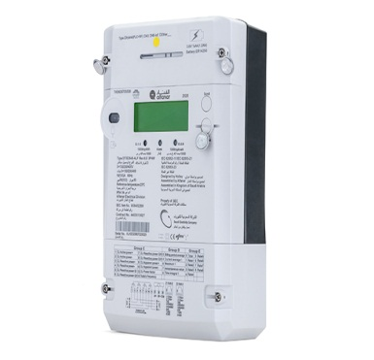
Introduction
What is a smart meter?
Digital Metering Device
It is an advanced digital device that automatically record energy consumption and transmit data to the utility company and the user.
Real-Time Data
It provide real-time energy usage information, empowering users to monitor and manage their consumption effectively
Notes:
4. Nowadays there is a rise in distributed energy resources which make the system more complex

Slide 6
Problem
Notes:
ب

Slide 7


Problem
Current local energy meters lack several features:
They generally measure energy without identifying the type of device consuming it.
lack of visibility on future consumption.
They can malfunction without the knowledge of the supplier or consumer, or electricity theft.
Emerging distributed energy resources (DER) at distribution networks which make the system more complex.
Notes:
4. Each device is monitored individually.Because we cannot determine the primary cause of the rise and fall in consumption.
We also require periodic human inspections to ensure the condition of the meters, as we do not have a logical methodology for sudden changes or malfunctions. Nowadays there is a rise in distributed energy resources which make the system more complex

Slide 8
Solutions

Slide 9
Solutions
Each solution has a benefit:-
Help users understand which appliances consume the most energy, which save the cost and improve efficiency.
Load Disaggregation
Better management for future bills, also utilities can benefit to operate and manage the distribution network.
Load Forecasting
To detect suspicious consumption behavior and smart meter health.
Check-up Detection
Notes:
Smaller this

Slide 10
Proposed Framework

Slide 11

Proposed Framework
Input
Smart-Meter
Data
Cloud Storage
Algorithm
Solutions
Load Disaggregation
Load Disaggregation
Load Forecasting
Load Forecasting
Check-up Detection
Self-diagnosed
Bidirectional

Slide 12
Load Disaggregation

Slide 13
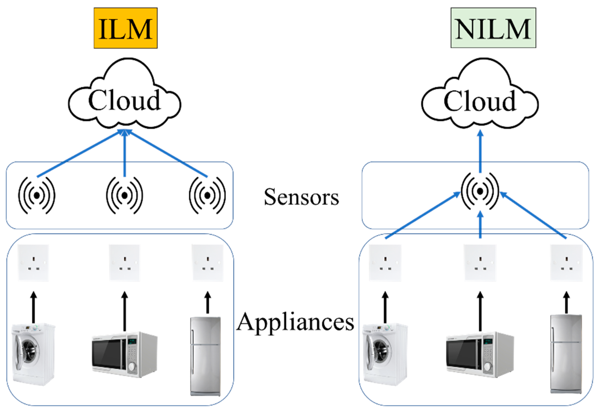
Load Disaggregation
Introduction
It’s a way to measure the load of the appliance
There are two ways:
Traditional Appliance Load Monitoring (using current sensors and other devices)
Non-intrusive Load Monitoring(NILM)

Slide 14
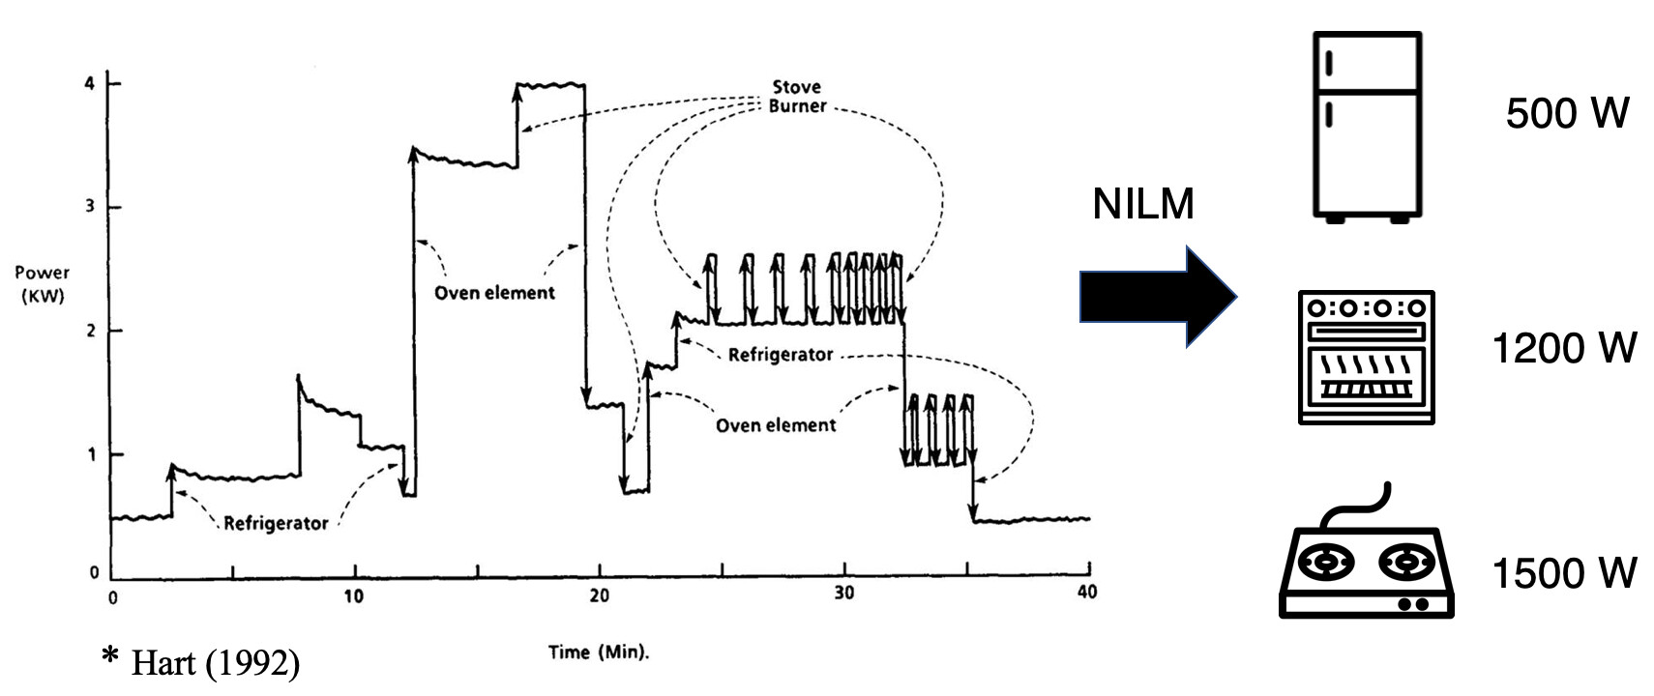
Load Disaggregation
NILM?
It’s a way to monitor appliance load using Machine learning and signal processing

Slide 15
Load Disaggregation Algorithm

Slide 16
Load Disaggregation Algorithm
Comparison of load disaggregation Algorithm
Learning Algorithm | Features Used | Accuracy (%) | Training Type
HMM | Steady-State | 75–95 | Supervised and Unsupervised
KNN | Steady-State and transient | 70–90 | Supervised
Optimization | Steady-State | 60–95 | Supervised
https://pmc.ncbi.nlm.nih.gov/articles/PMC3571813/

Slide 17
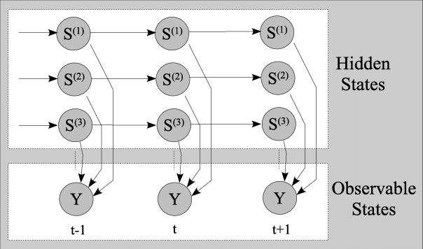
Load Disaggregation
Model
Factorial Hidden Markov Model
Notes:
1️⃣ Clustering improved_cluster() Identify appliance states 2️⃣ Training FHMM.train()Train individual HMMs
3️⃣ Combination create_combined_hmm()Build full FHMM 4️⃣ Disaggregation FHMM.disaggregate() Separate total load
5️⃣ Save/Loadsave() / load()Reuse models later

Slide 18
Load forecasting

Slide 19

Load forecasting
Objectives:
Consumer Insight: Enable users to estimate future bills and manage consumption.
Grid Stability: Help utilities anticipate peak demand.
Security Baseline: Establish a "Normal Behavior" reference for theft detection.

Slide 20
Load forecasting algorithm
We used Long Short-Term Memory (LSTM) as our algorithm
LSTM is a neural network that depends on both long-term memory and short-term memory.

Slide 21
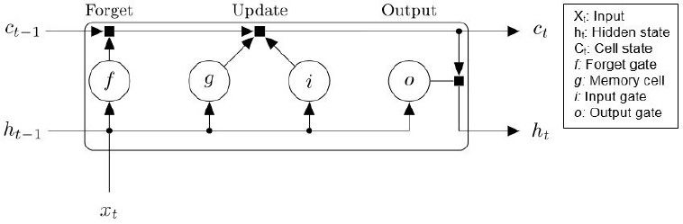
LSTM
Input: Current power consumption
Hidden state: power before 10 minutes
Cell state: Its summer season
Forgot gate: In summer, no heater
Input gate: allow information about AC and high tempreture
Output gate: forecast

Slide 22
Theft Detection

Slide 23
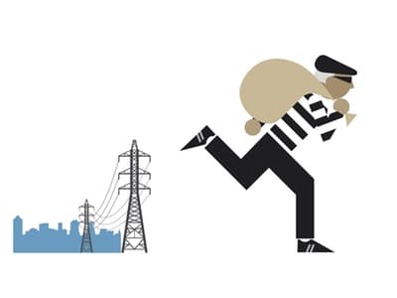
Electricity theft
Electricity theft losses rose from $89.3 billion in 2014 to $96 billion in 2017.
According to a World Bank report, India, China, and Brazil lose 25%, 6%, and 16%, respectively of their total revenue annually due to NTLs (Non-Technical losses).
https://www.sciencedirect.com/science/article/abs/pii/S037877962200205X

Slide 24
Algorithm

Slide 25
Algorithm-CUSUM
Cumulative sum (CUSUM) display the deviation from a target value
In our smart meter CUSUM works on detecting small changes that cumulate above a mean or specified value.

Slide 26
CUSUM Implementation
There are Two ways in implementing CUSUM:
Implementing CUSUM on the daily measurement of electricity
Implementing CUSUM On the monthly electricity consumption and comparing it with the results obtained from load forecasting

Slide 27
Dataset

Slide 28

Dataset
Dataset
REFIT
The REFIT Electrical Load Measurements dataset includes electrical consumption data in Watts for 20 households at aggregate and appliance level, timestamped and sampled at 8 second intervals.

Slide 29
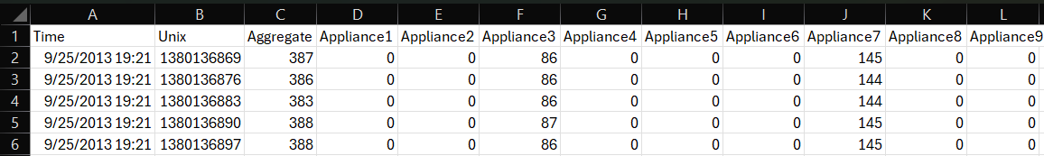

Load Disaggregation
Dataset
Description

Slide 30
Results

Slide 31
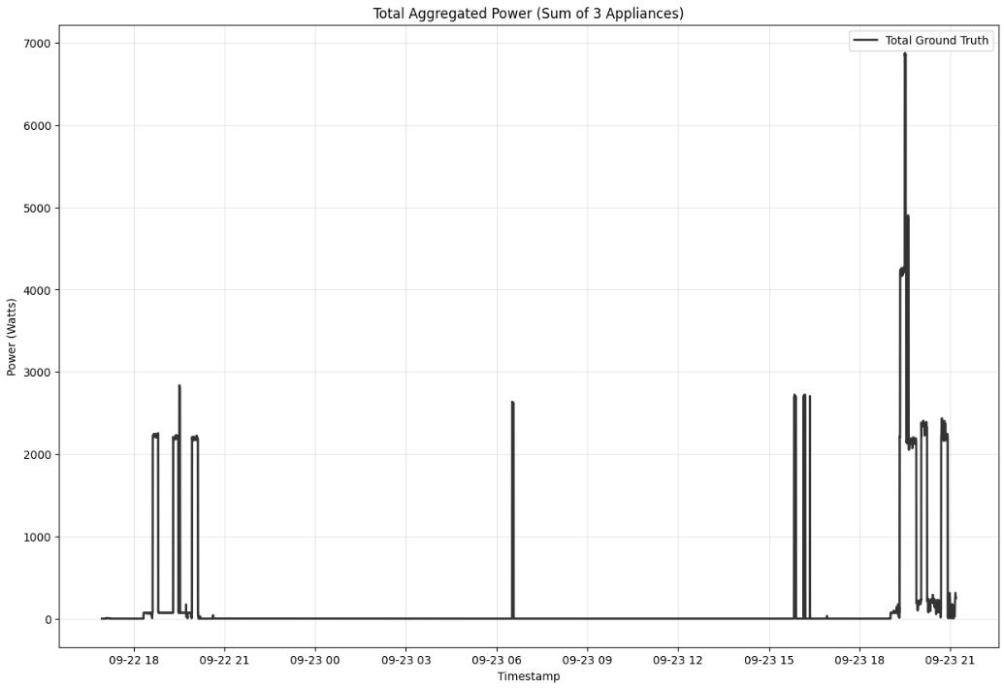
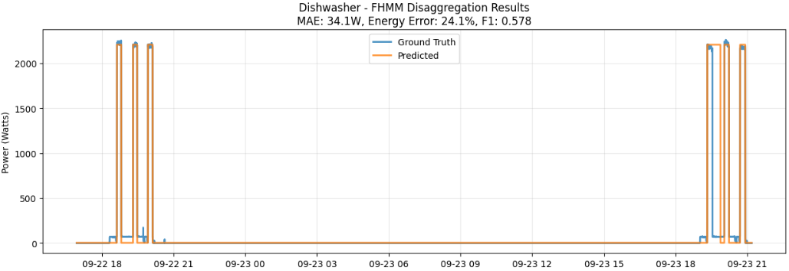
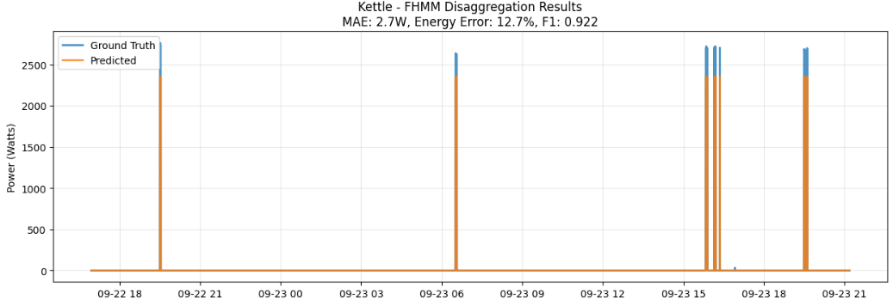
Load disaggregation results

Slide 32
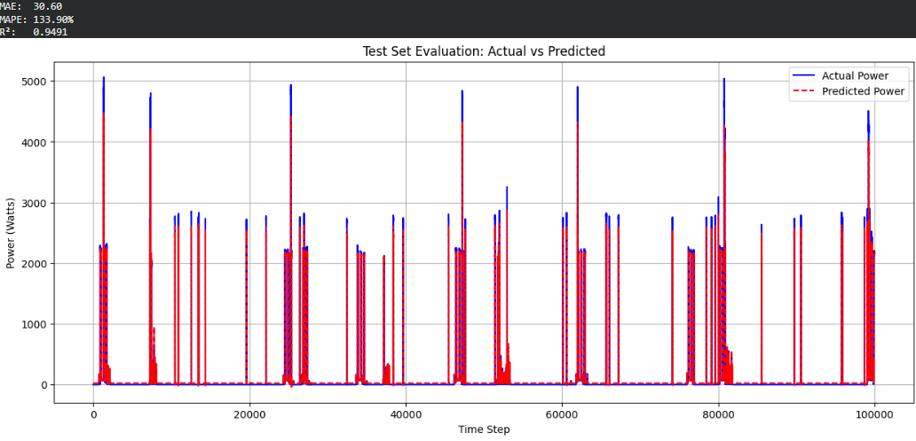
Load forecasting results

Slide 33
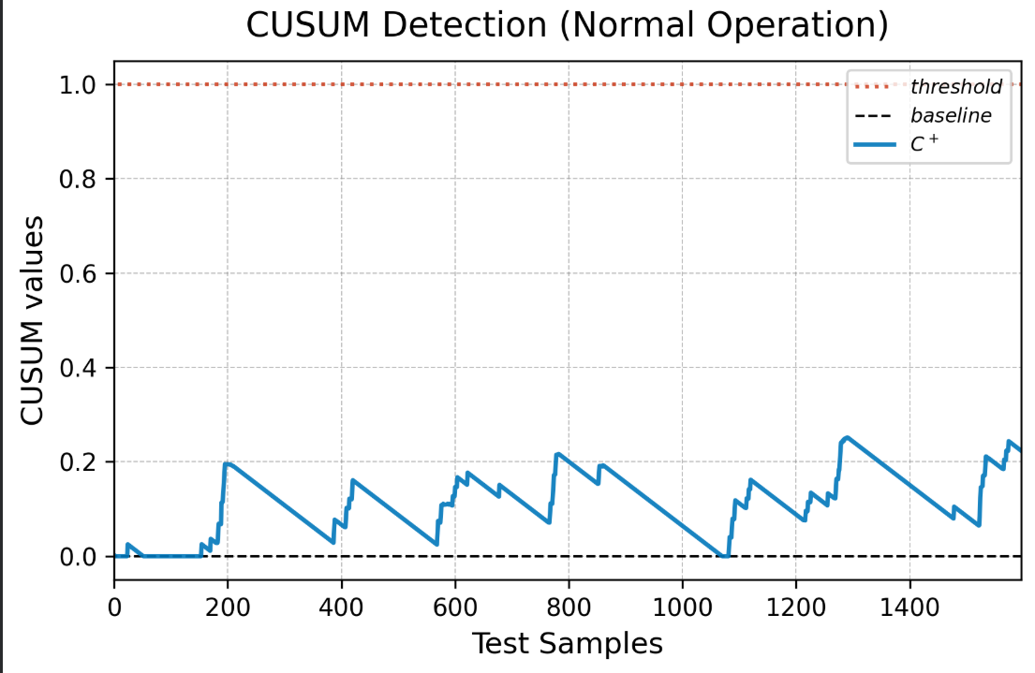
Theft detection results
We draw the CUSUM of normal house then we added a theft equal to 1 appliance, 2 appliance, and a house.

Slide 34
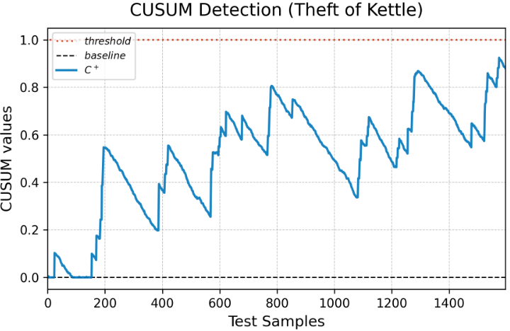
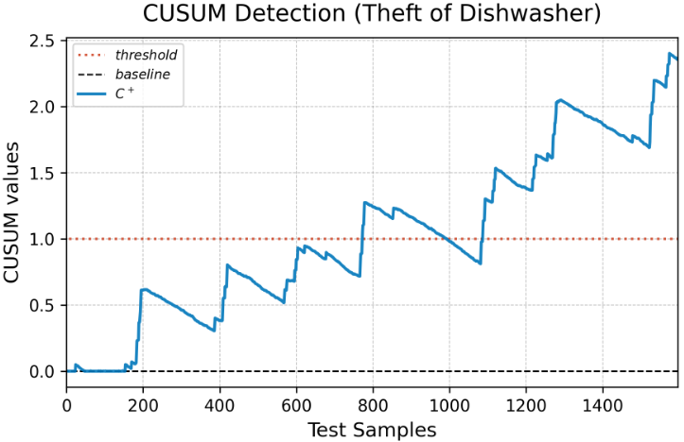
Theft detection results
Theft equal to 1 Appliance scenario:

Slide 35
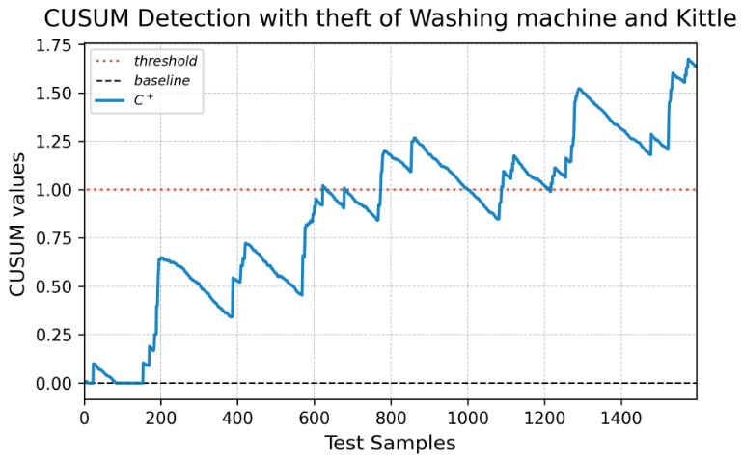
Theft detection results
Theft equal to 2 Appliance scenario:

Slide 36
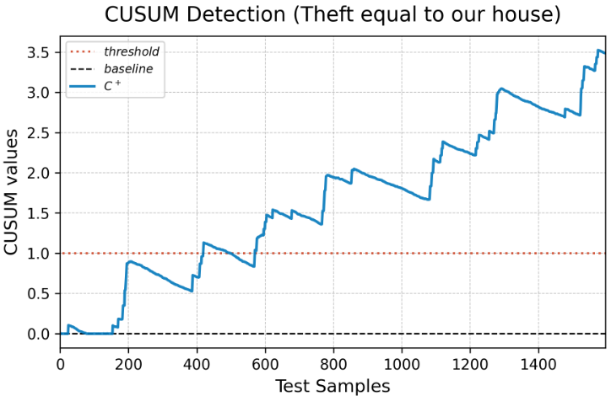
Theft detection results
Theft equal to our house scenario:

Slide 37
Implementation

Slide 38
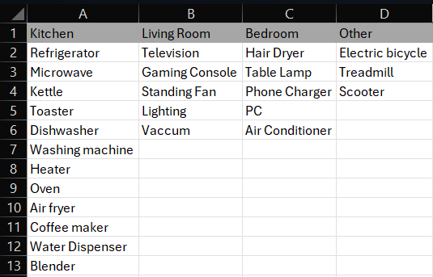
Prototype
For the prototype we first looked up for the traditional appliances on a Saudi House to do a real simulation and collecting data
List of the appliances:

Slide 39
Prototype
We setup the environment with the following:
Appliances
Sub-meters
Computer

Slide 40
Prototype
We setup the environment with the following:
Sub-meters: we used Orangepi, Esp32, and a circuit breaker

Slide 41
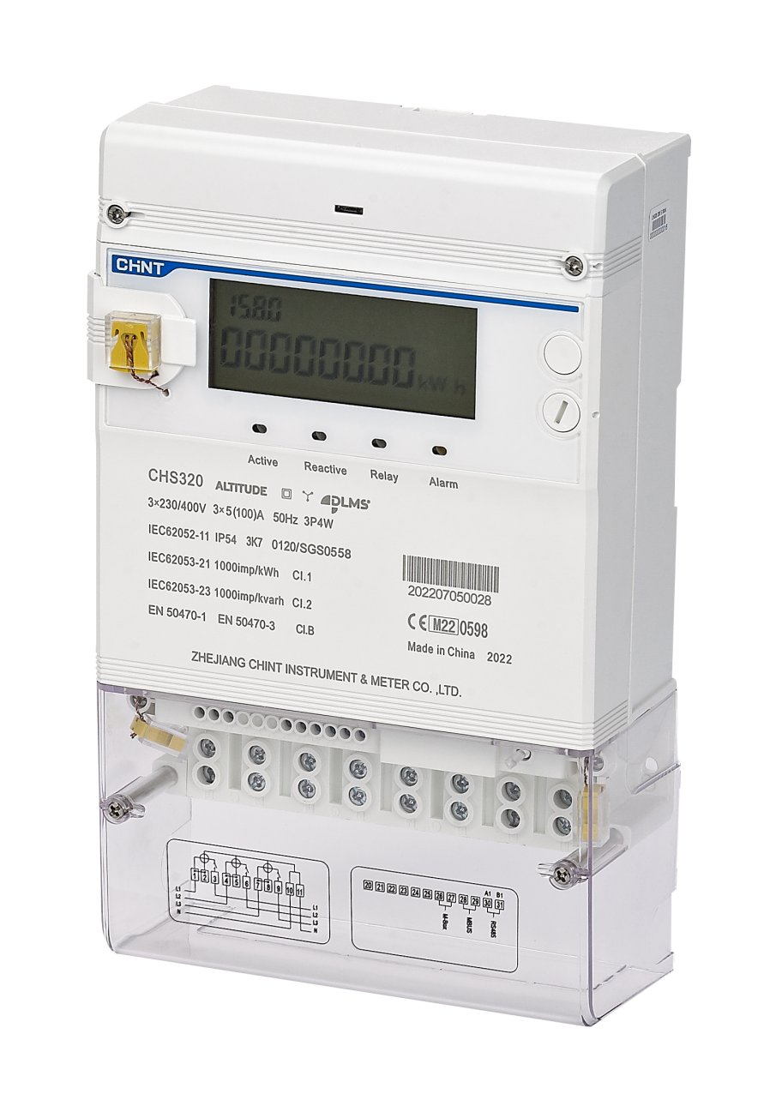
Prototype
Prototype :
We will use CHINT’s smart meter

Slide 42
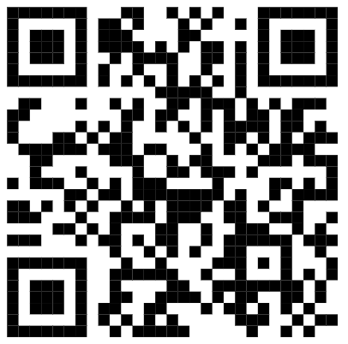
Prototype-Survey
Creating a Survey
We did a survey to distinguish the normal working hours of each of our devices
Scan the code

Slide 43
Comparison

Slide 44



Comparison
Comparison with current companies
Company | Load Disaggregation | Load Forecasting | Check-up Detection | Bidirectional
Ohmconnect | No | Yes | No | No
Enetics | NO | Yes (For utility) | No | Yes
Bidgely | Yes | Yes | Partial (Electrical theft only) | NO
INTELLI-METER | Yes | Yes | Yes | Yes

Slide 45
Conclusion
We moved beyond simple tracking to show users how they use energy, not just how much.
We taught the system to distinguish between an actual thief and a simple hot day consumption.
We created a software "brain" for analytics and a hardware "nervous system" to capture accurate data.
This isn't just a prototype; it is a scalable step toward the smart grid envisioned in Vision 2030.

Slide 46
Thanks
Notes:
The aim of this Intelli-Meter is to collect data from the appliances first then the integration of the Intelli-Meters collect data from the houses and work as a source of data to a digital twin what is a digital twin?
It is a replica of the whole system of electricity (grid)

